Slide 1

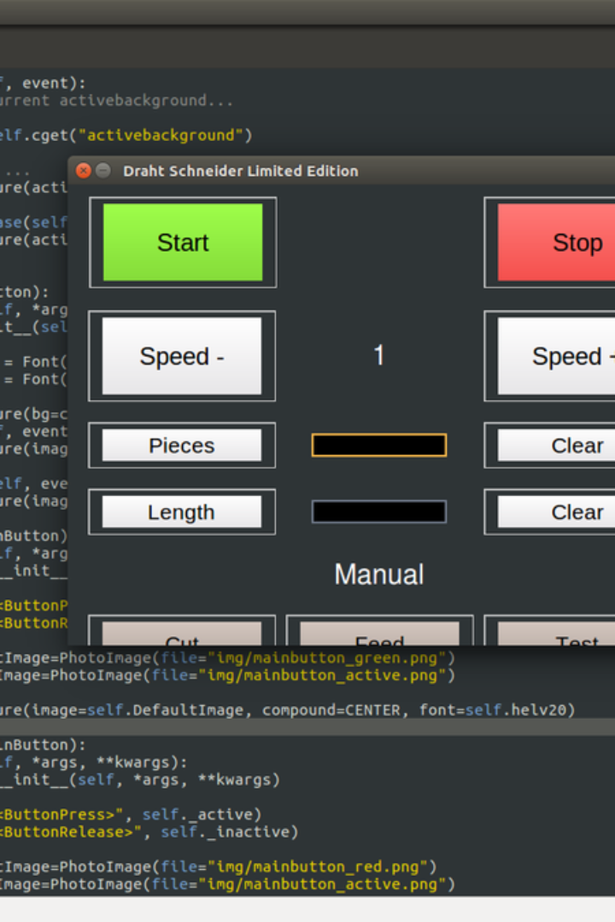

Tkinter in Python - Usage, Importance, and Sample Code
Tkinter is the standard GUI (Graphical User Interface) toolkit for Python. It is used to create desktop applications with widgets and common GUI elements.
by ANIK ACHARJEE

Slide 2
What is Tkinter?
Tkinter is the standard package for creating GUI applications in Python. It provides a fast and easy way to build interfaces in Python programs.
Simple and Easy
Easy-to-use library for creating GUI applications.
Built-In Widgets
Comes with a variety of built-in widgets for UI design.
Widespread Use
Widely used due to its simplicity and effectiveness.

Slide 3
Importance of Tkinter in Python
Tkinter plays a crucial role in Python application development, especially for those interested in building user-friendly interfaces.
Default Library
Comes pre-installed with Python, no need for extra installation.
Accessible without additional downloads or configuration.
Platform Independence
Code once, run anywhere - Tkinter supports major platforms.
Develop GUI applications that can be deployed across multiple OS environments.

Slide 4
Creating GUI Elements with Tkinter
Developers use Tkinter to create various GUI elements, from buttons and labels to input fields and drop-down menus.
Buttons
Add interactivity to your applications.
Labels
Display text or images.
Input Fields
Collect user input.
Drop-down Menus
Select items from a list.

Slide 5
Adding Functionality with Tkinter
Functionalities like event handling and connecting backend logic to the interface can be seamlessly implemented using Tkinter.
Event Handling
Respond to user actions, interactions, and inputs.
Backend Integration
Connect GUI components with application logic.

Slide 6
Styling and Theming with Tkinter
Developers can customize the appearance of their applications by applying various styles and themes using Tkinter.
Custom Styles
Create personalized visual elements.
Theme Selection
Select from built-in or custom themes for the application.

Slide 7
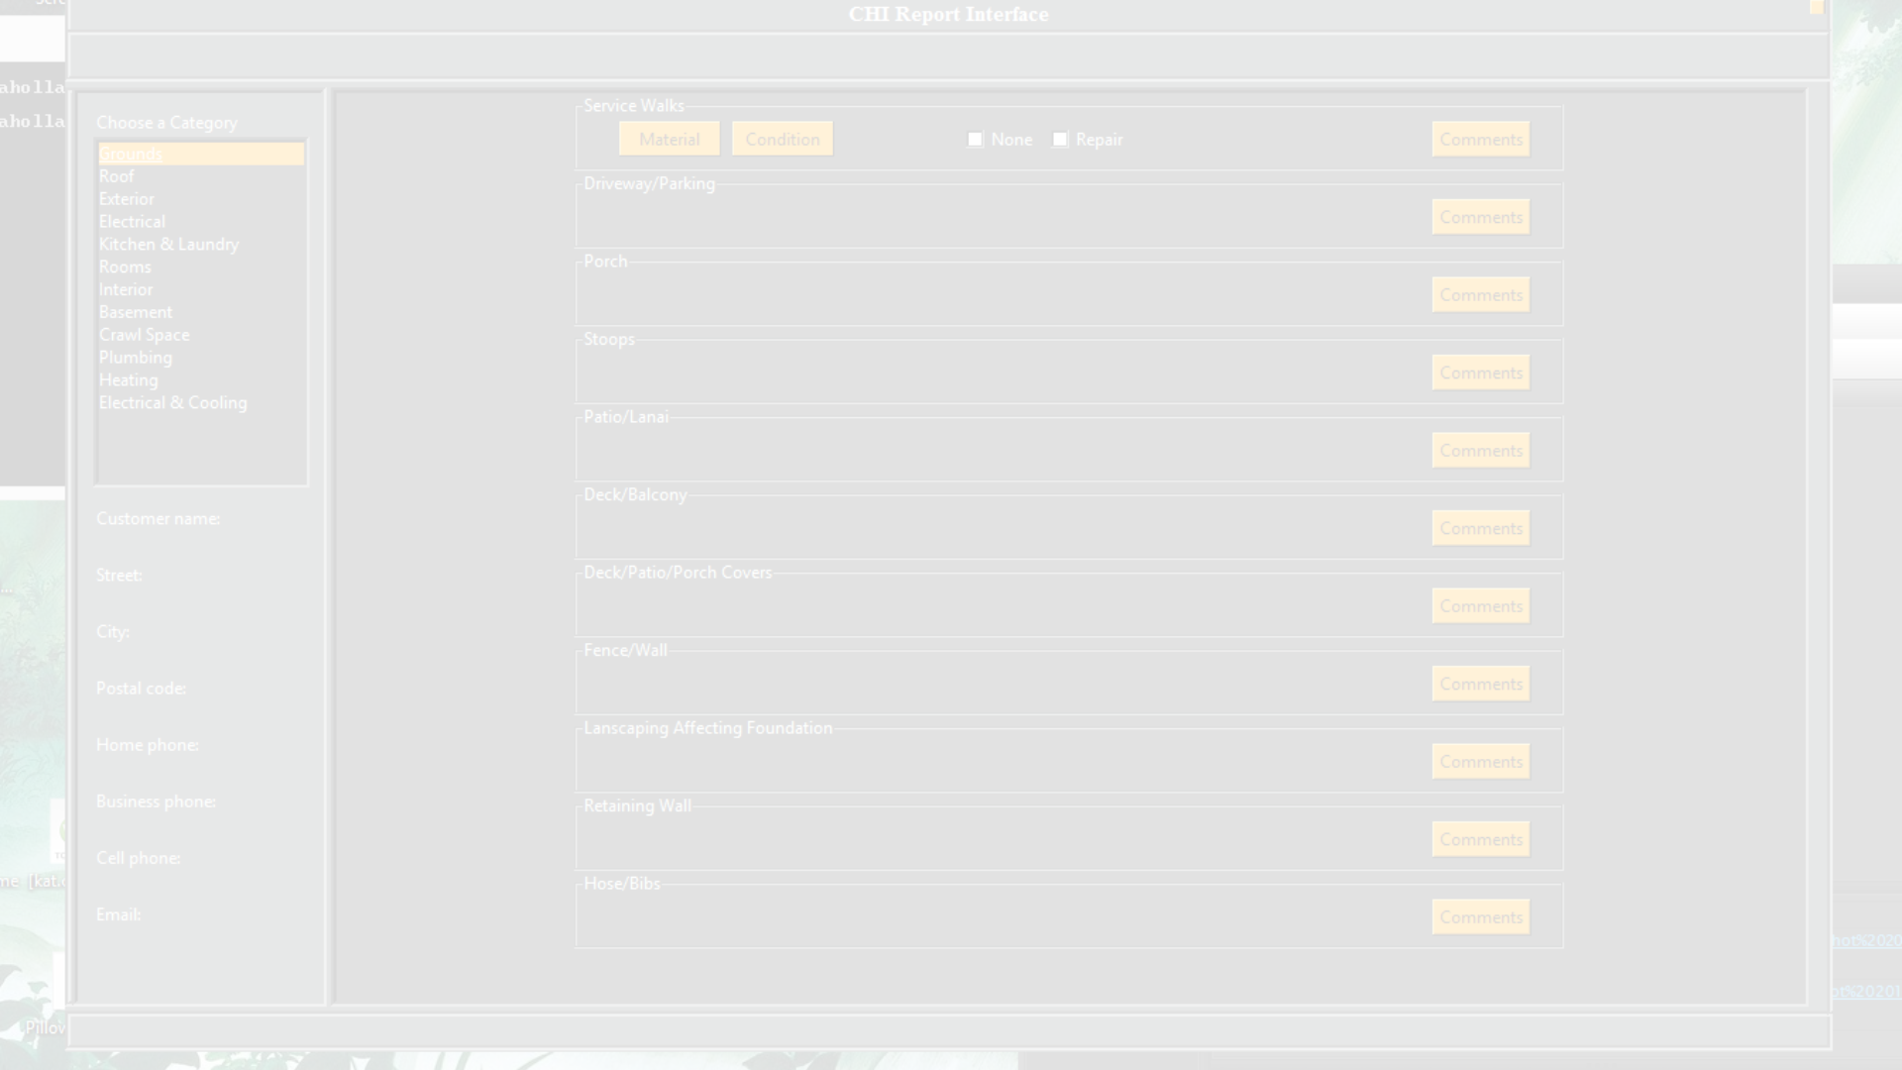
Tkinter in Action: A Simple Code Example
Here's a basic example of creating a window with a button using Tkinter:
import tkinter as tk
def on_button_click():
label.config(text="Button clicked!")
# Create the main window
window = tk.Tk()
window.title("Tkinter Example")
# Create a label
label = tk.Label(window, text="Hello, Tkinter!")
label.pack(pady=10)
# Create a button
button = tk.Button(window, text="Click me!", command=on_button_click)
button.pack()
# Start the Tkinter event loop
window.mainloop()

Slide 8
Getting Started with Tkinter
For those new to Tkinter, learning the basics by building simple applications is a great way to start.
Step 1
Install Python and Tkinter (if not included).
Step 2
Set up your development environment.
Step 3
Follow Tkinter tutorials and create simple GUI applications.

Slide 9
Conclusion: Tkinter for Python GUI Development
Tkinter provides a beginner-friendly approach to creating visual desktop applications in Python, making it an essential tool for Python developers.
Beginner-Friendly
Easy to learn and suitable for beginners.
Versatile
Allows building a wide range of GUI applications.
Effective
Provides an effective means for creating user interfaces.

